Slide 1
Probability Theory

Slide 2
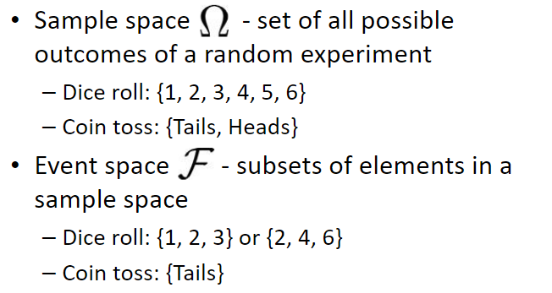
Events and Sample Space
Sample Space:
for a procedure Sample Space consists of all possible simple events; that is, the sample space consists of all outcomes that cannot be broken down any further
Event
any collection of results or outcomes of a procedure
Simple Event
an outcome or an event that cannot
be further broken down into simpler
components

Slide 3
Events and Sample Space
A pair of dice are rolled. The sample space has 36 simple events:
1,1 1,2 1,3 1,4 1,5 1,6
2,1 2,2 2,3 2,4 2,5 2,6
3,1 3,2 3,3 3,4 3,5 3,6
4,1 4,2 4,3 4,4 4,5 4,6
5,1 5,2 5,3 5,4 5,5 5,6
6,1 6,2 6,3 6,4 6,5 6,6
where the pairs represent the numbers rolled on each dice.
Which elements of the sample space correspond to the event that the sum of each dice is 4?

Slide 4

Probability
The word 'Probability' means the chance of occurring of a particular event.
It is generally possible to predict the future of an event quantitatively with a certain probability of being correct.
The probability is used in such cases where the outcome of the trial is uncertain.
P - denotes a probability.
A, B, and C - denote specific events.
P(A) - denotes the probability of event A occurring.

Slide 5
Probability
Probability of an Event Defined over (Ω, Ғ) s.t.
0 < P(a) <1 for all a in Ғ
P(Ω) = 1
Probability of an event which is certain to occur is one.
Probability of an event which is impossible to zero.
If the probability of happening of an event P(A) and that of not happening is P(A’), then P(A) + P(A’) = 1,
where, 0 ≤ P(A) ≤ 1, 0≤ P(A’)≤1.

Slide 6
Event Relations
Equally Likely Events: Events are said to be equally likely if one of them cannot be expected to occur in preference to others. In other words, it means each outcome is as likely to occur as any other outcome.
Example: When a die is thrown, all the six faces, i.e., 1, 2, 3, 4, 5 and 6 are equally likely to occur.
Mutually Exclusive or Disjoint Events: Events are called mutually exclusive if they cannot occur simultaneously.
Example: Suppose a card is drawn from a pack of cards, then the events getting a jack and getting a king are mutually exclusive because they cannot occur simultaneously.

Slide 7
Event Relations
Exhaustive Events: The total number of all possible outcomes of an experiment is called exhaustive events.
Example: In the tossing of a coin, either head or tail may turn up. Therefore, there are two possible outcomes. Hence, there are two exhaustive events in tossing a coin.
Dependent Event: Events are said to be dependent if occurrence of one affect the occurrence of other events.
Independent Events: Events A and B are said to be independent if the occurrence of any one event does not affect the occurrence of any other event.
P (A ∩ B) = P (A) P (B).

Slide 8
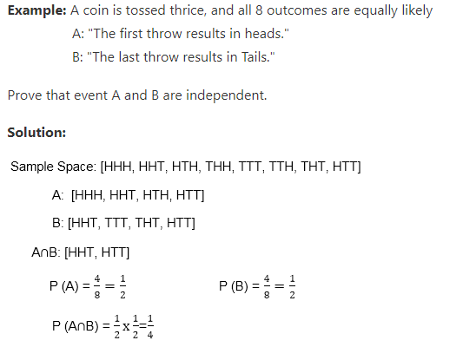
Event Relations

Slide 9
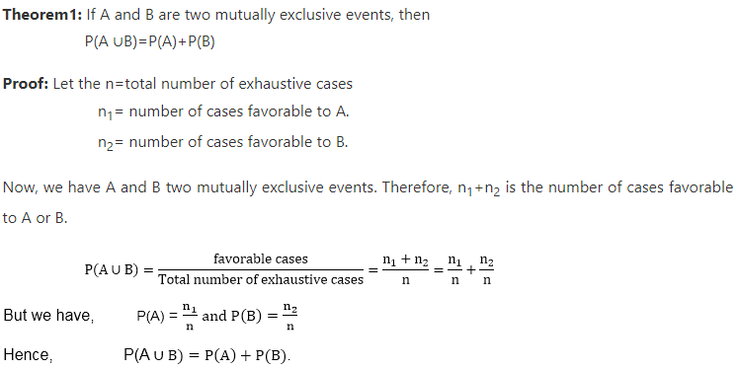
Event Relations

Slide 10
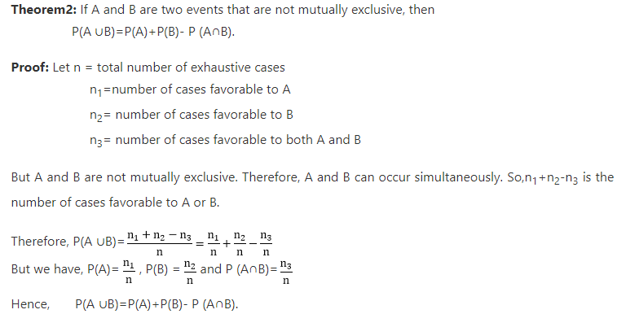
Event Relations

Slide 11
Conditional Probability
The probability of an event A based on the occurrence of another event B is termed conditional Probability. It is denoted as P(A|B) and represents the probability of A when event B has already happened.
P(A | B) = P(A∩B)/ P(B)
If the two events are independent:
P(A∩B) = P(A) ∗ P(B)
P(A/B) = P(A)
Sample space
A and B
B
A
Joint Probability:
The probability of two more events occurring together and at the same time is measured it is termed as Joint Probability.
Joint probability for two events A and B is denoted as, P(A∩B).

Slide 12
Bayes Theorem
Bayes theorem, also known as the Bayes Rule, is used to determine the conditional probability of event A when event B has already happened.
“The conditional probability of an event A, given the occurrence of another event B, is equal to the product of the probability event of B given A and the probability of A divided by the probability of event B.” i.e.
P(A|B) = P(B|A)P(A) / P(B) given P(B) ≠ 0
where,
P(A) and P(B) are the probabilities of events A and B
P(A|B) is the probability of event A when event B happens
P(B|A) is the probability of event B when event A happens

Slide 13
Theorem of Total Probability
Let E1, E2,…………..En are mutually exclusive and exhaustive events associated with a random experiment and lets E be an event that occurs with some Ei.
Then,
P(E) = ^{n}∑_{i=1}P(E/E_{i}) . P(E_{i})
B₅
B₃
B₂
B₄
A
B₁
B₇
B₆

Slide 14
Questions
Q1. Two dice are thrown. The events A, B, C, D, E, F
A = getting even number on first die.
B= getting an odd number on the first die.
C = getting a sum of the number on dice ≤ 5
D = getting a sum of the number on dice > 5 but less than 10.
Show that:
1. A, B are a mutually exclusive event and Exhaustive Event.
2. A, C are not mutually exclusive.
3. C, D are a mutually exclusive event but not Exhaustive Event.
4. A'∩B' are a mutually exclusive and exhaustive event.

Slide 15
Questions
Q2. A bag contains 5 green and 7 red balls. Two balls are drawn. Find the probability that one is green and the other is red.
Q3. Find the probability of drawing a heart on each of two consecutive draws from well shuffled-packs of cards if the card is not replaced after the draw.
Q4. “X+Y=6 or X+Y=7” – given this (and only this), what is the probability of Y=5?
Q5. There are three urns containing 3 white and 2 black balls; 2 white and 3 black balls; 1 black and 4 white balls respectively. There is an equal probability of each urn being chosen. One ball is equal probability chosen at random. what is the probability that a white ball is drawn?

